Slide 1


Project Preparation

Slide 2

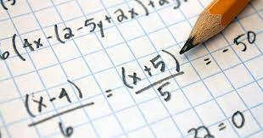

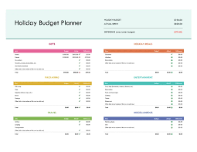
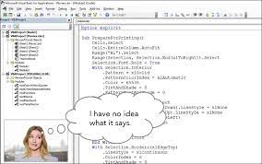
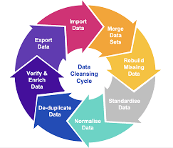
Excel
The Best Way to Store Data
You can perform calculations
All the tools for data analysis
Easy to Create Data Visualizations with Charts
You can Print Reports Easily
So many free templates to use
You can code to automate
Transform and clean data

Slide 3
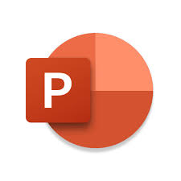



PowerPoint
PowerPoint Is most used to create slideshows
Allows the user full access to customization and organisation
PowerPoint allows users to add transitions
PowerPoint offers a variety of built-in templates
Many Options for file sharing
PowerPoint supports presenter view.

Slide 4



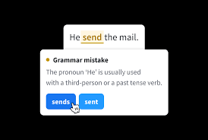
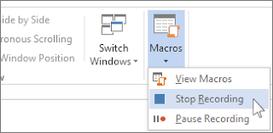
Word
Microsoft Word is an app used to create word docs
Allows the use to create and edit documents
Easy to create new word documents
Word allows people to collaborate using comments and live editing
It offers a wide range of templates
Word offer both grammar and spell check
Include charts, images etc.
Many options for file sharing
It provides advanced features such as macros. (More advanced Users)

Slide 5

Risk Assessment
Time Constraints
Not being able to finish our lesson

